Slide 1

Mountaineer
The D is silent.

Slide 2
Problem
Existing Apps are not designed for moutain climbers
They miss some important information:
Covered altitude
Time spent walking uphill/downhill
Calculation of calories

Slide 3
Solution

Slide 4
Solution
Android App
Specialized for Mountaineers

Slide 5
Functionality
Add tours/trips
Monitor weather and health information
Display details of completed tours
Tracking of altitude
Subject to change without prior notice.

Slide 6
What kind of Details?
General information
Track/Route details
Weather information
Health
Subject to change without prior notice.

Slide 7
Technical Stuff
Firebase
For Training Units
Used for Fast-Prototyping
Dedicated Database on Webserver for Production
More Details coming soon ;)
Subject to change without prior notice.

Slide 8
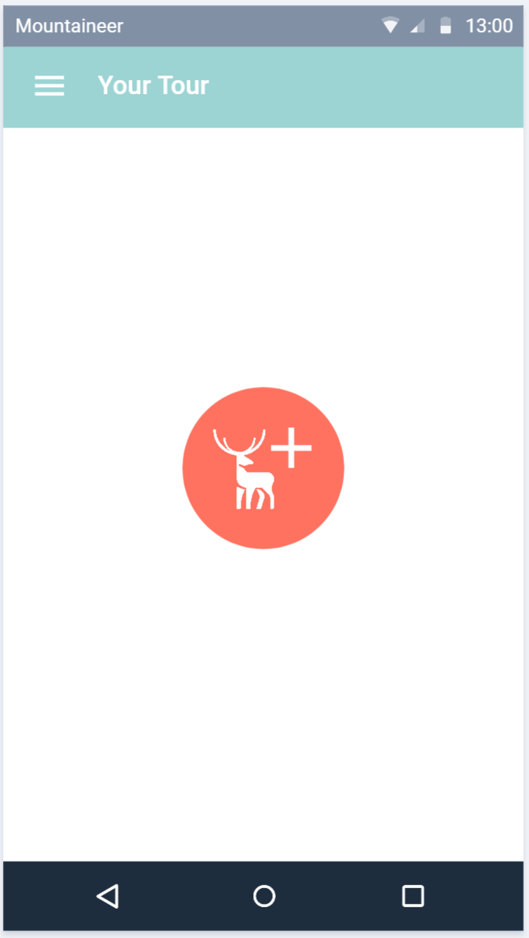
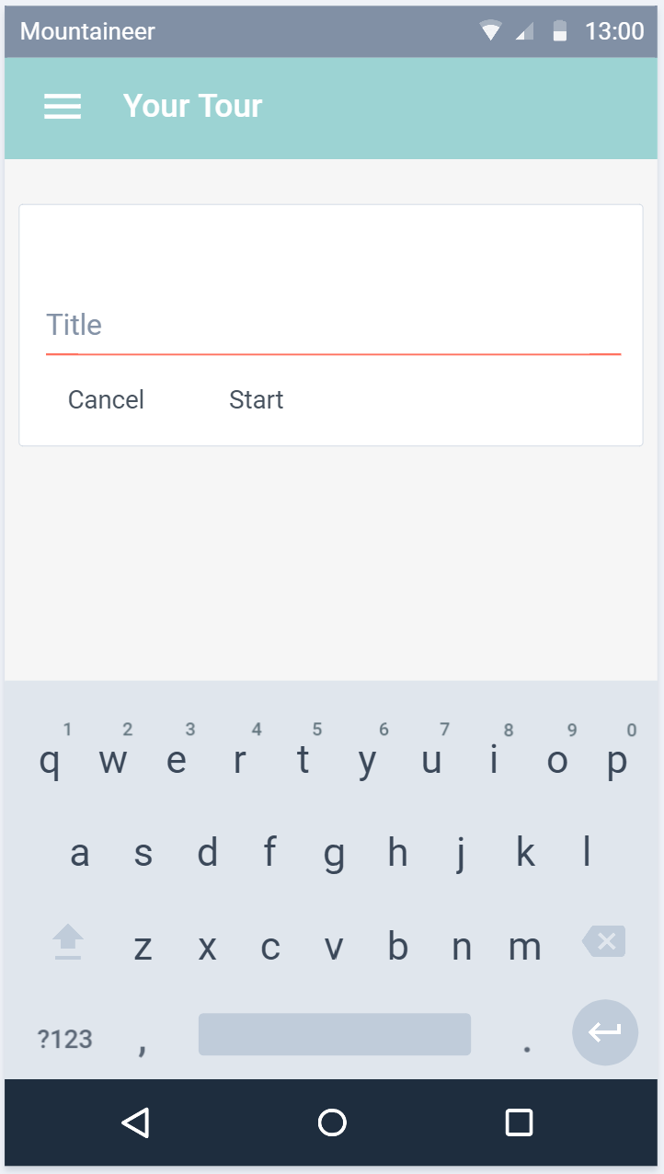
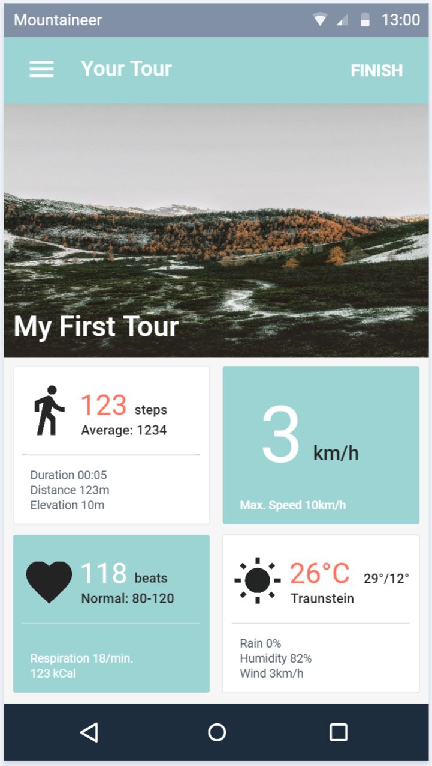
Planned Design
Subject to change without prior notice.

Slide 9
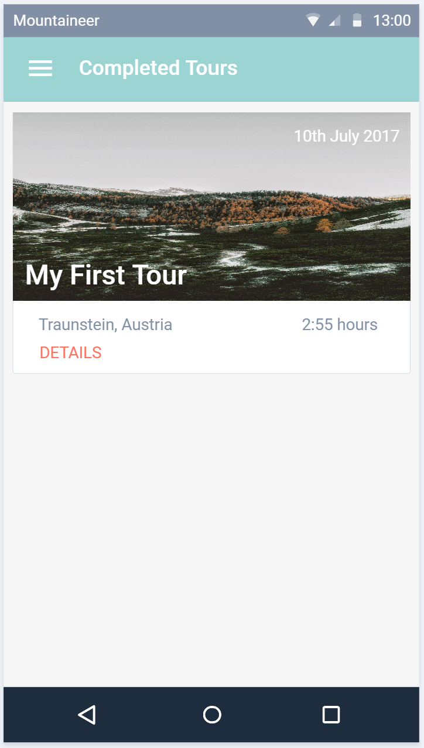
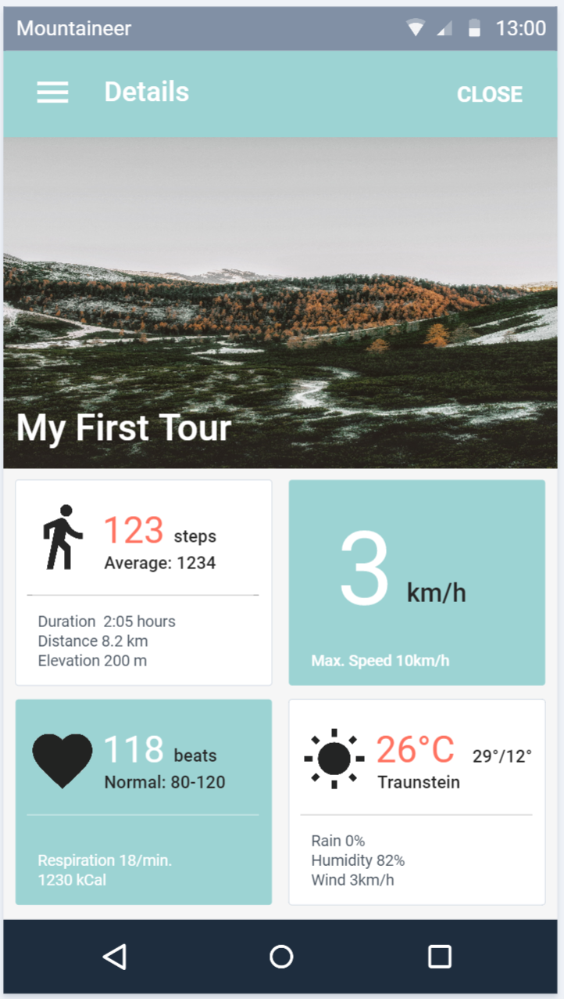
Planned Design
Subject to change without prior notice.

Slide 10
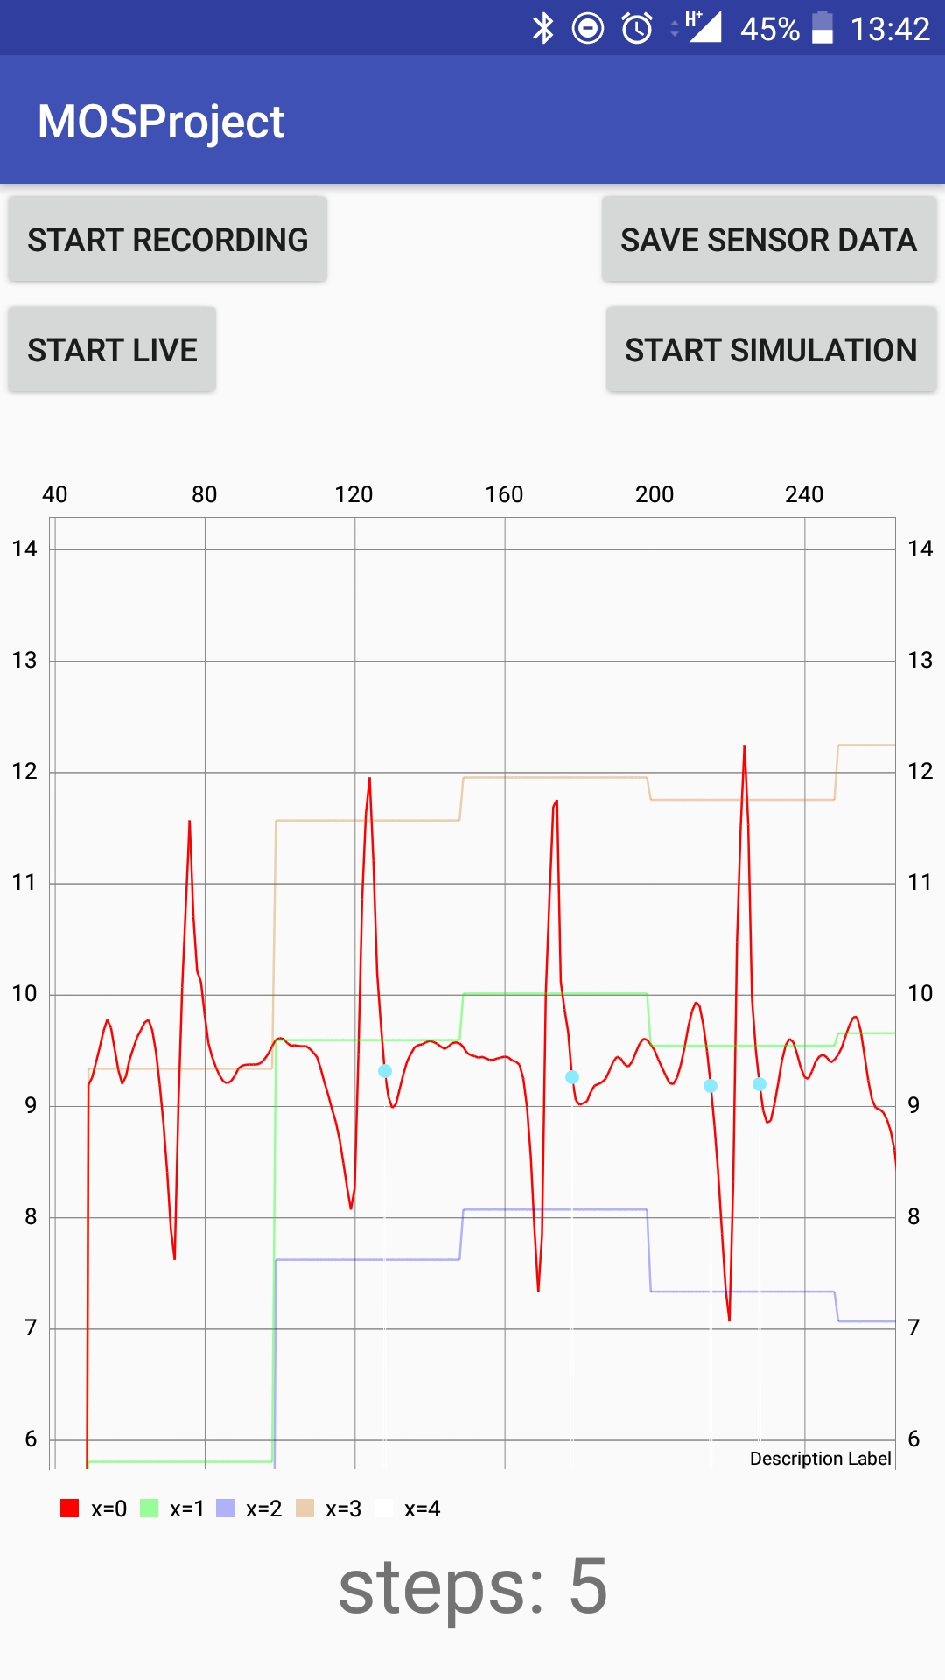
Pedometer
Simulation + Live-View
Graph
Used for debugging and testing
Firebase
Running as a Service
Implemented according to the PDF
But with little parameter adjustments

Slide 11
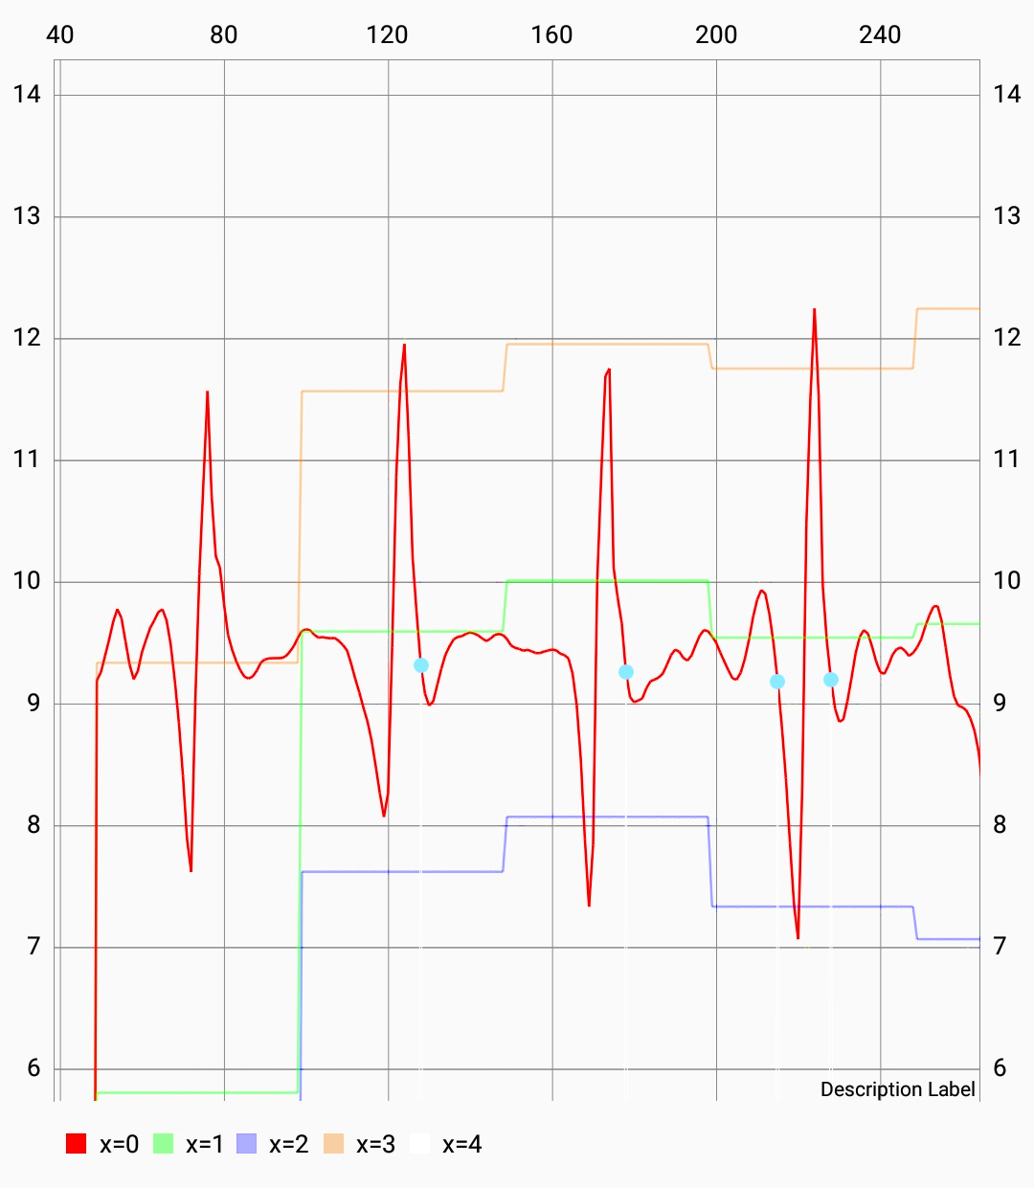
Chart Details
Measured values
Max + Min
Threshold
Detected steps

Slide 12
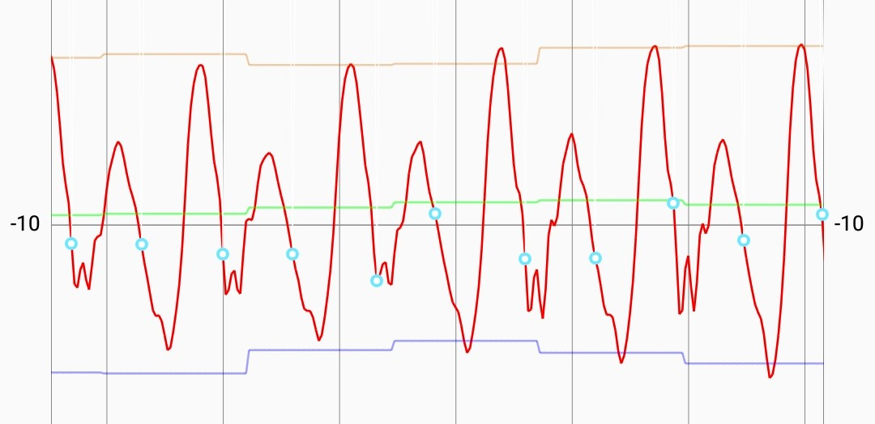
Acceleration of morning walk to FH

Slide 13
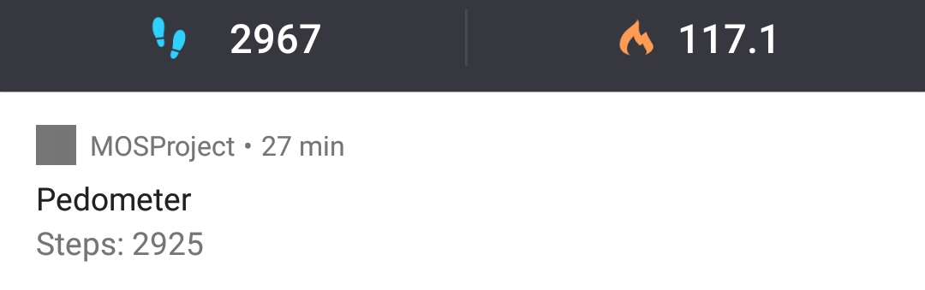
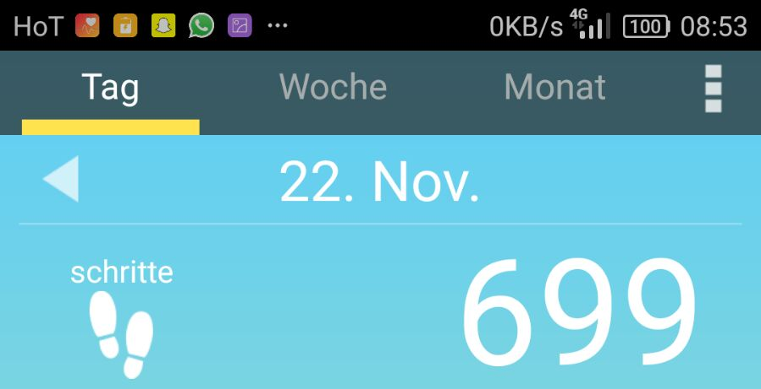
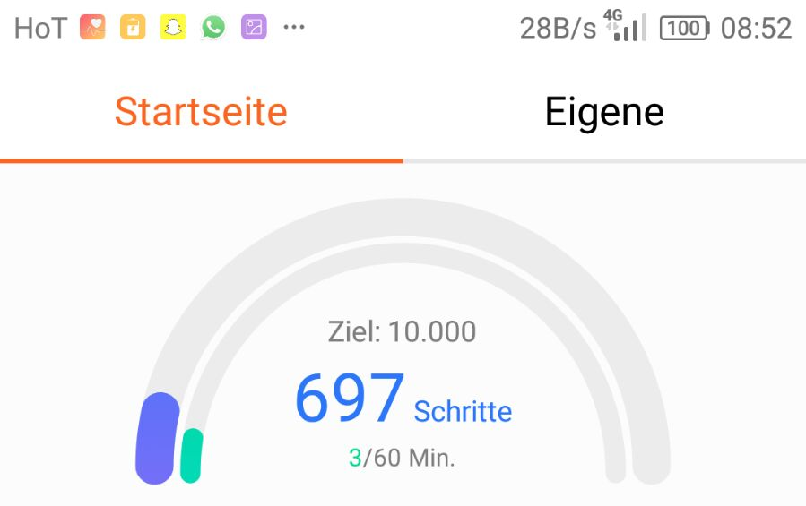
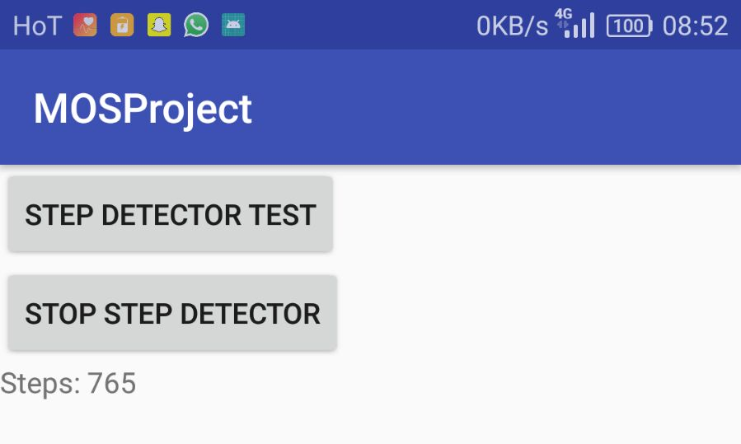
Competition Analysis
Accuracy compared to:
Pedometer
Huawei Health
Schrittzähler

Slide 14
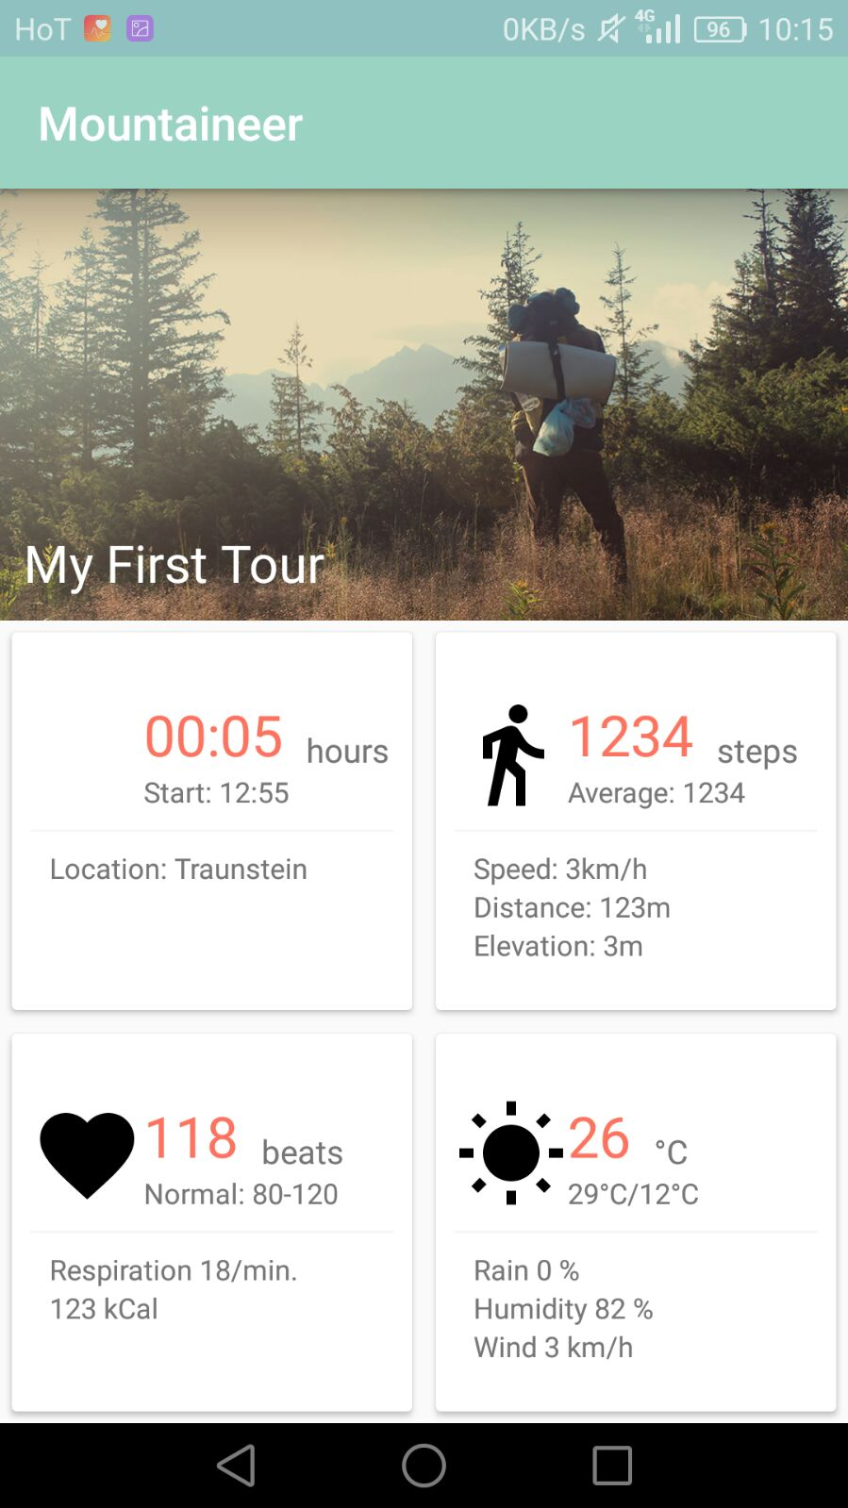
UI is (almost) ready
and waiting for functionality

Slide 15
Thanks!

Slide 16
Mountaineer
An Update.

Slide 17
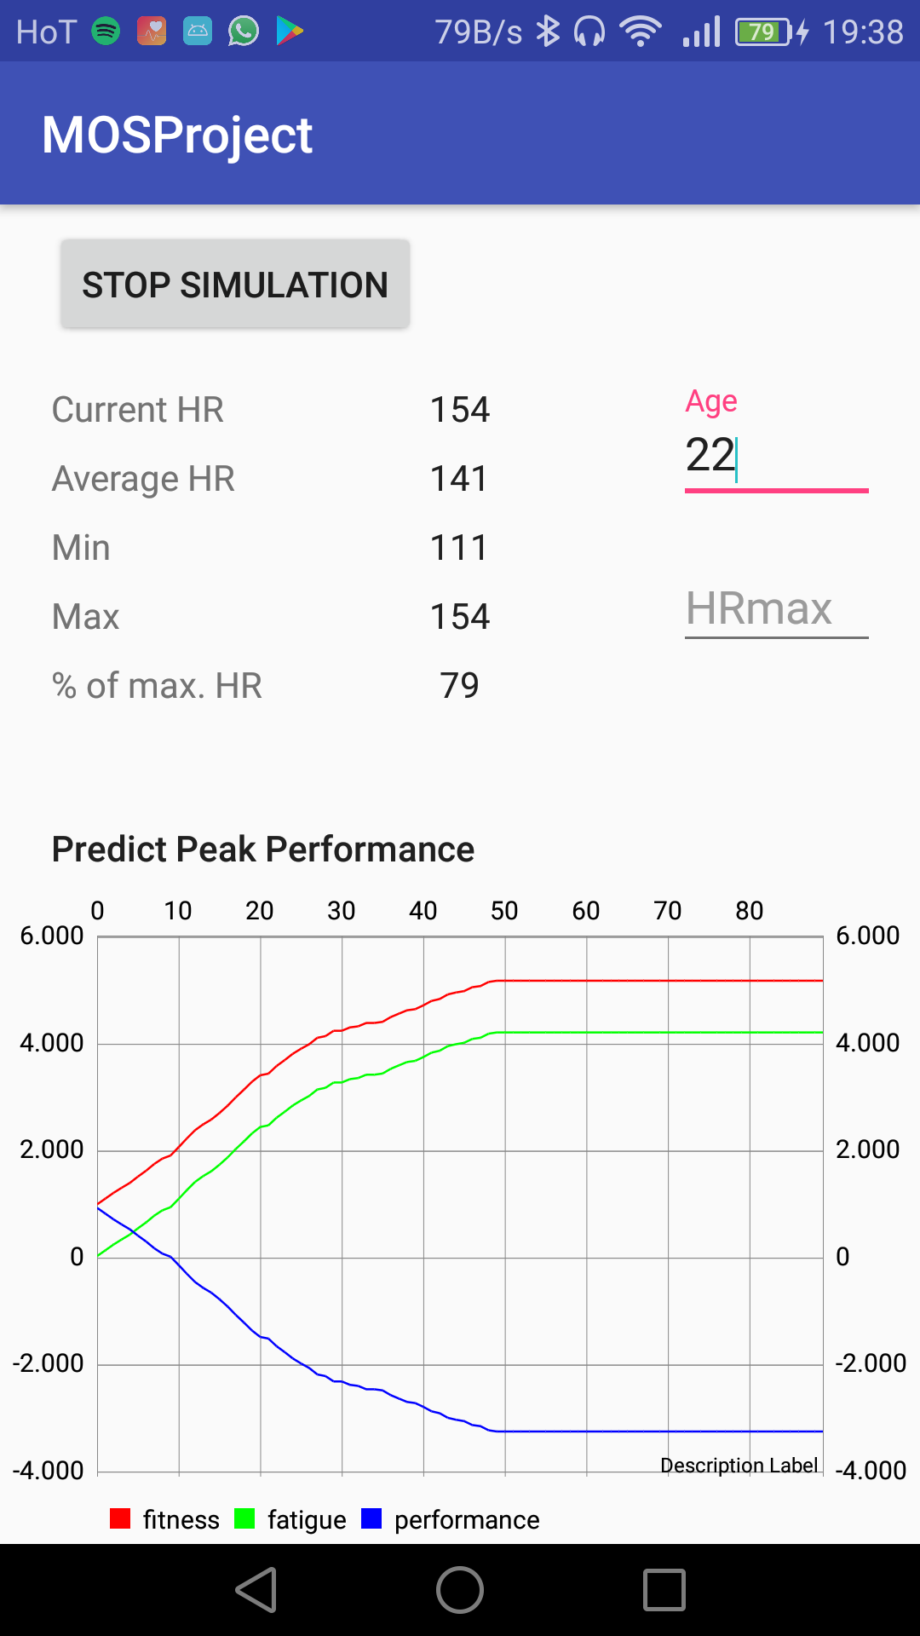
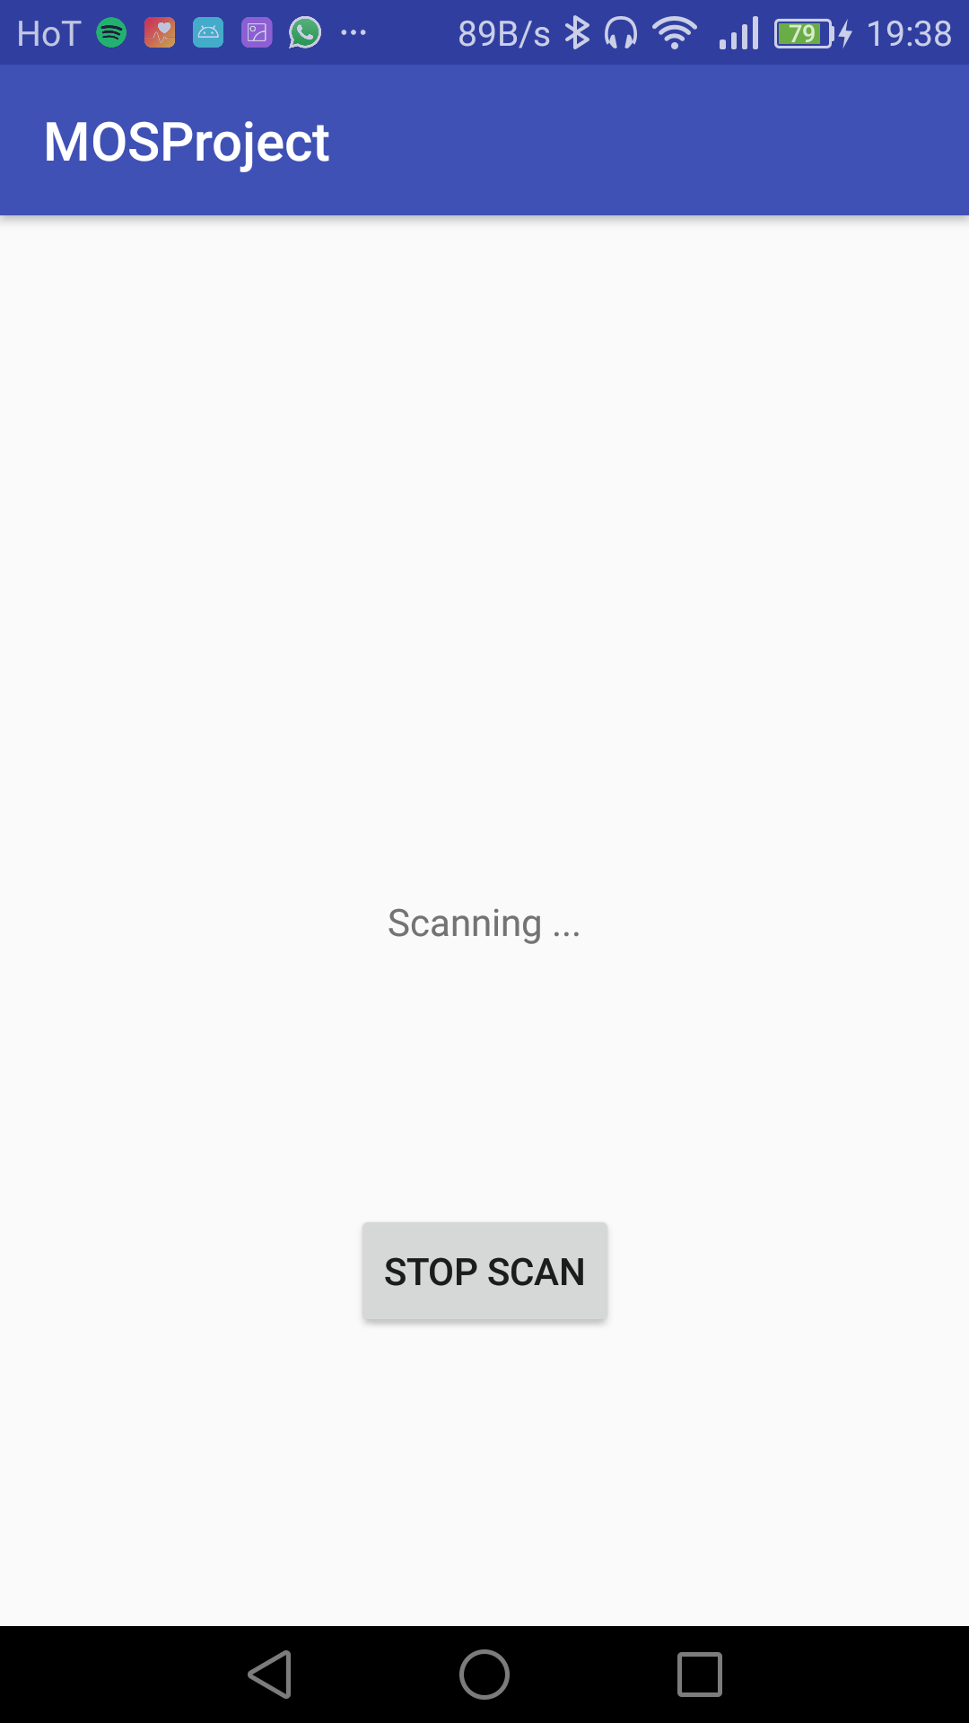
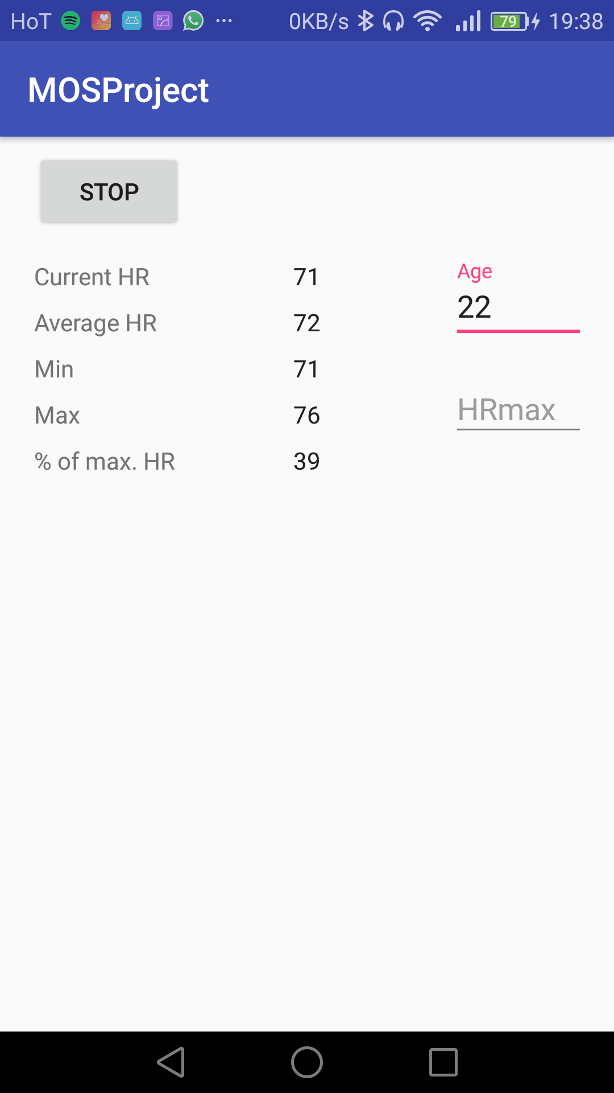
Heart Rate Monitoring

Slide 18
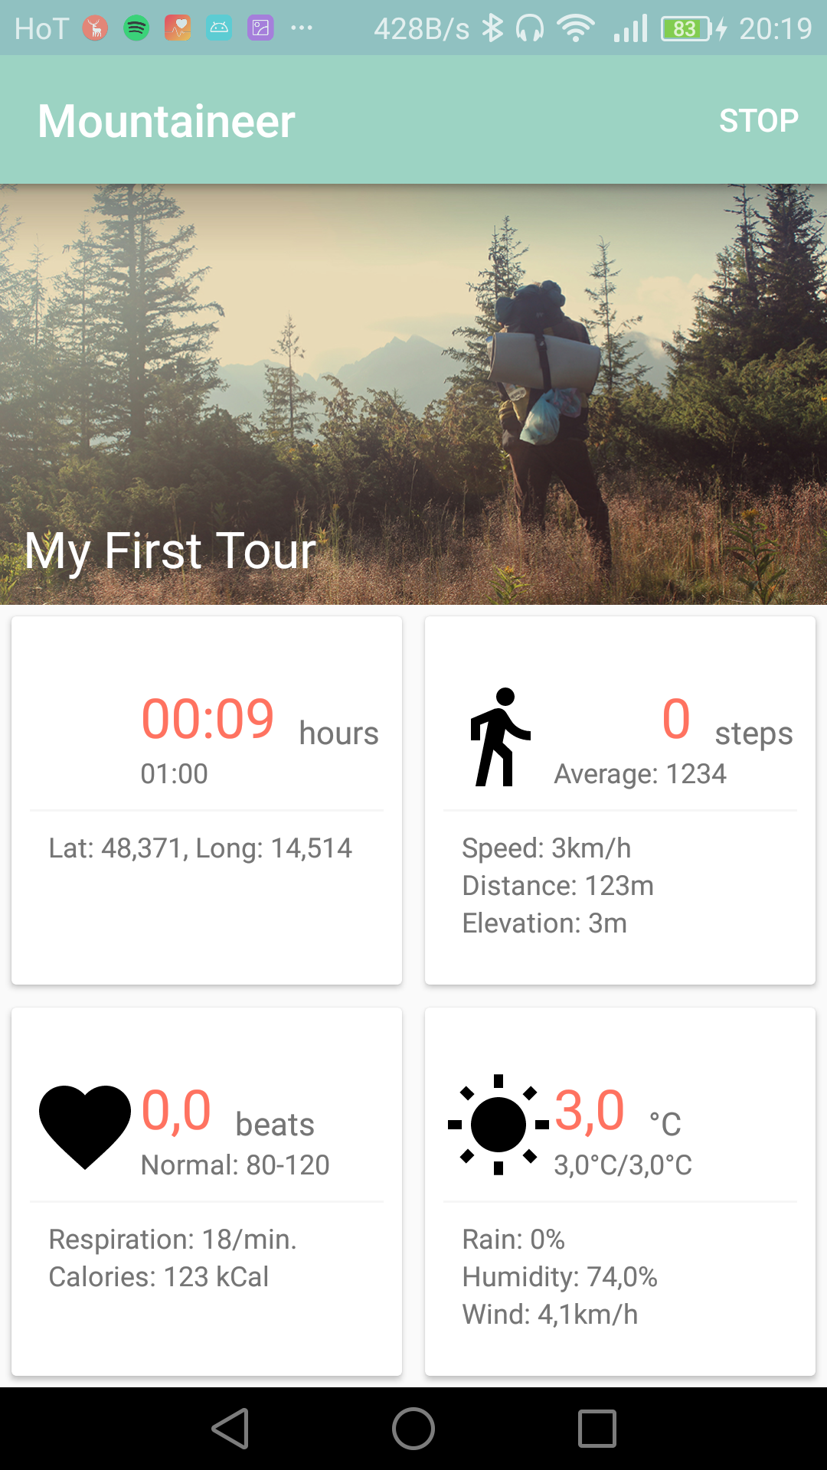
Android App #1

Slide 19
Android App #2

Slide 20
Android App #3

Slide 21
Android App #4

Slide 22
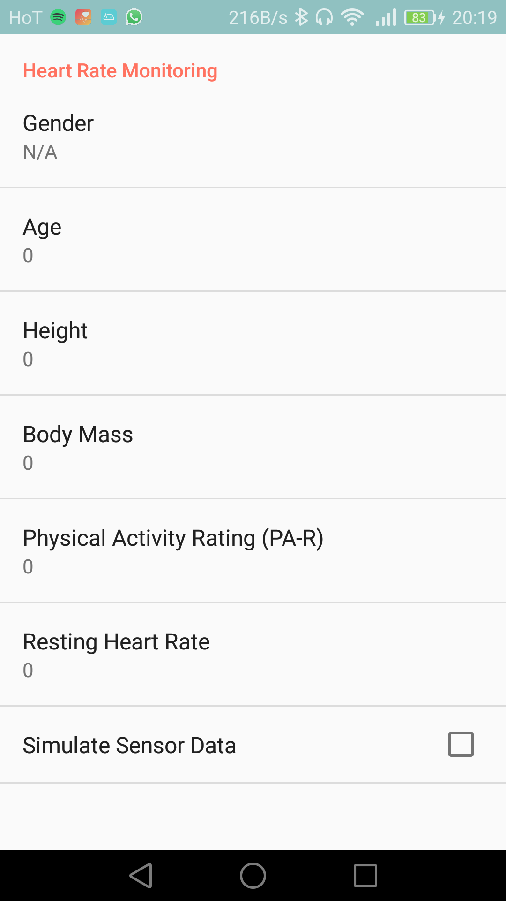
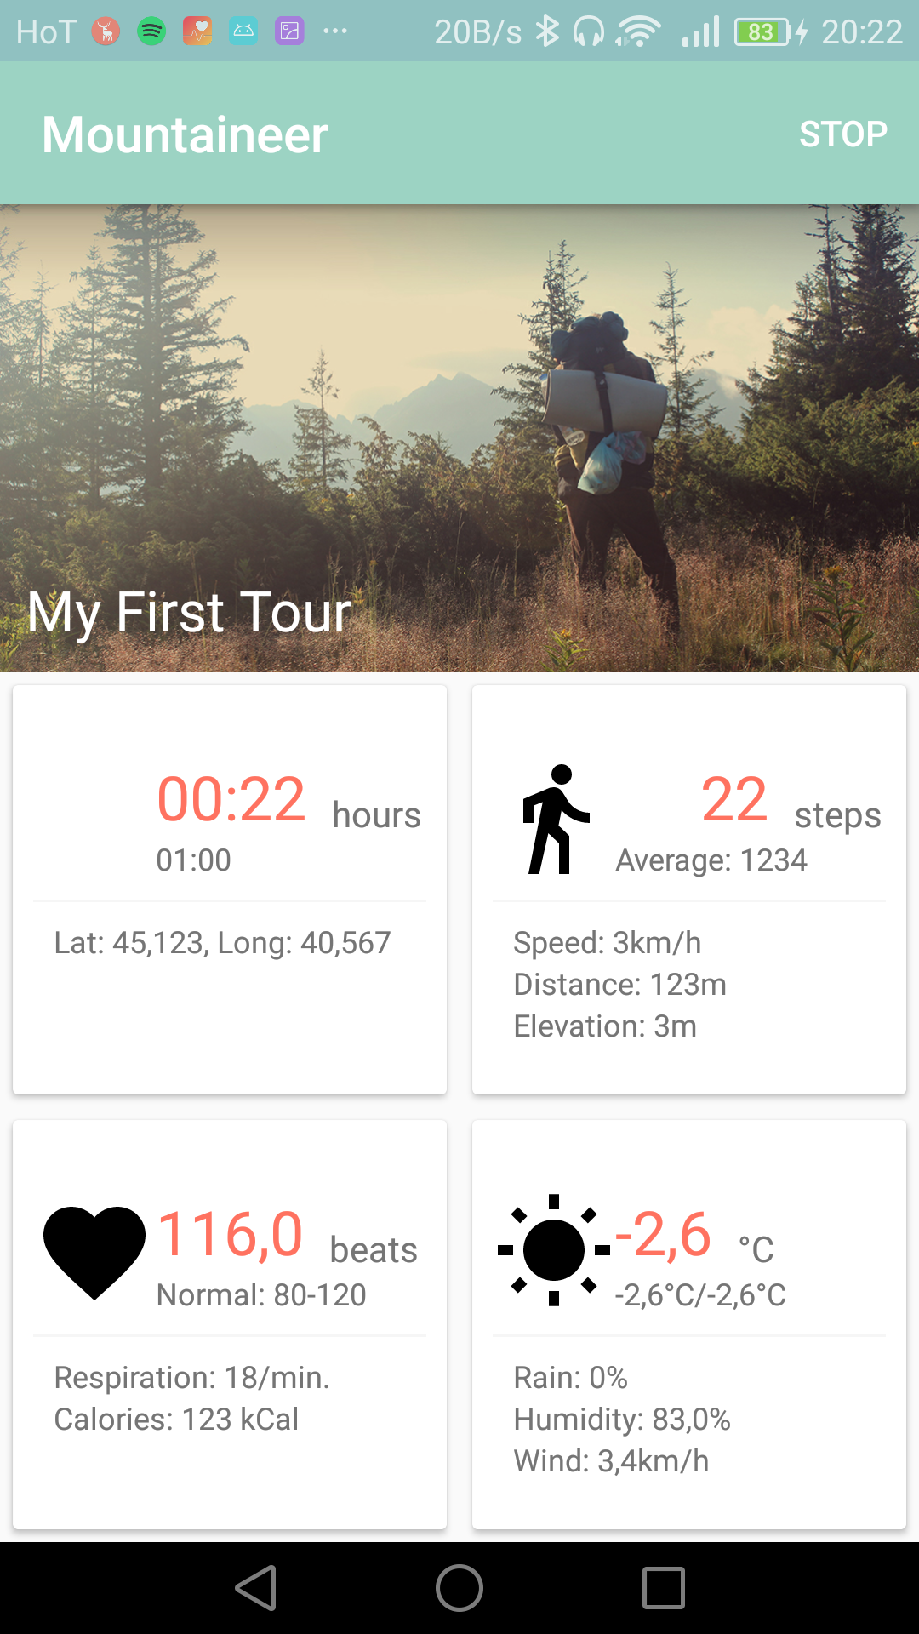
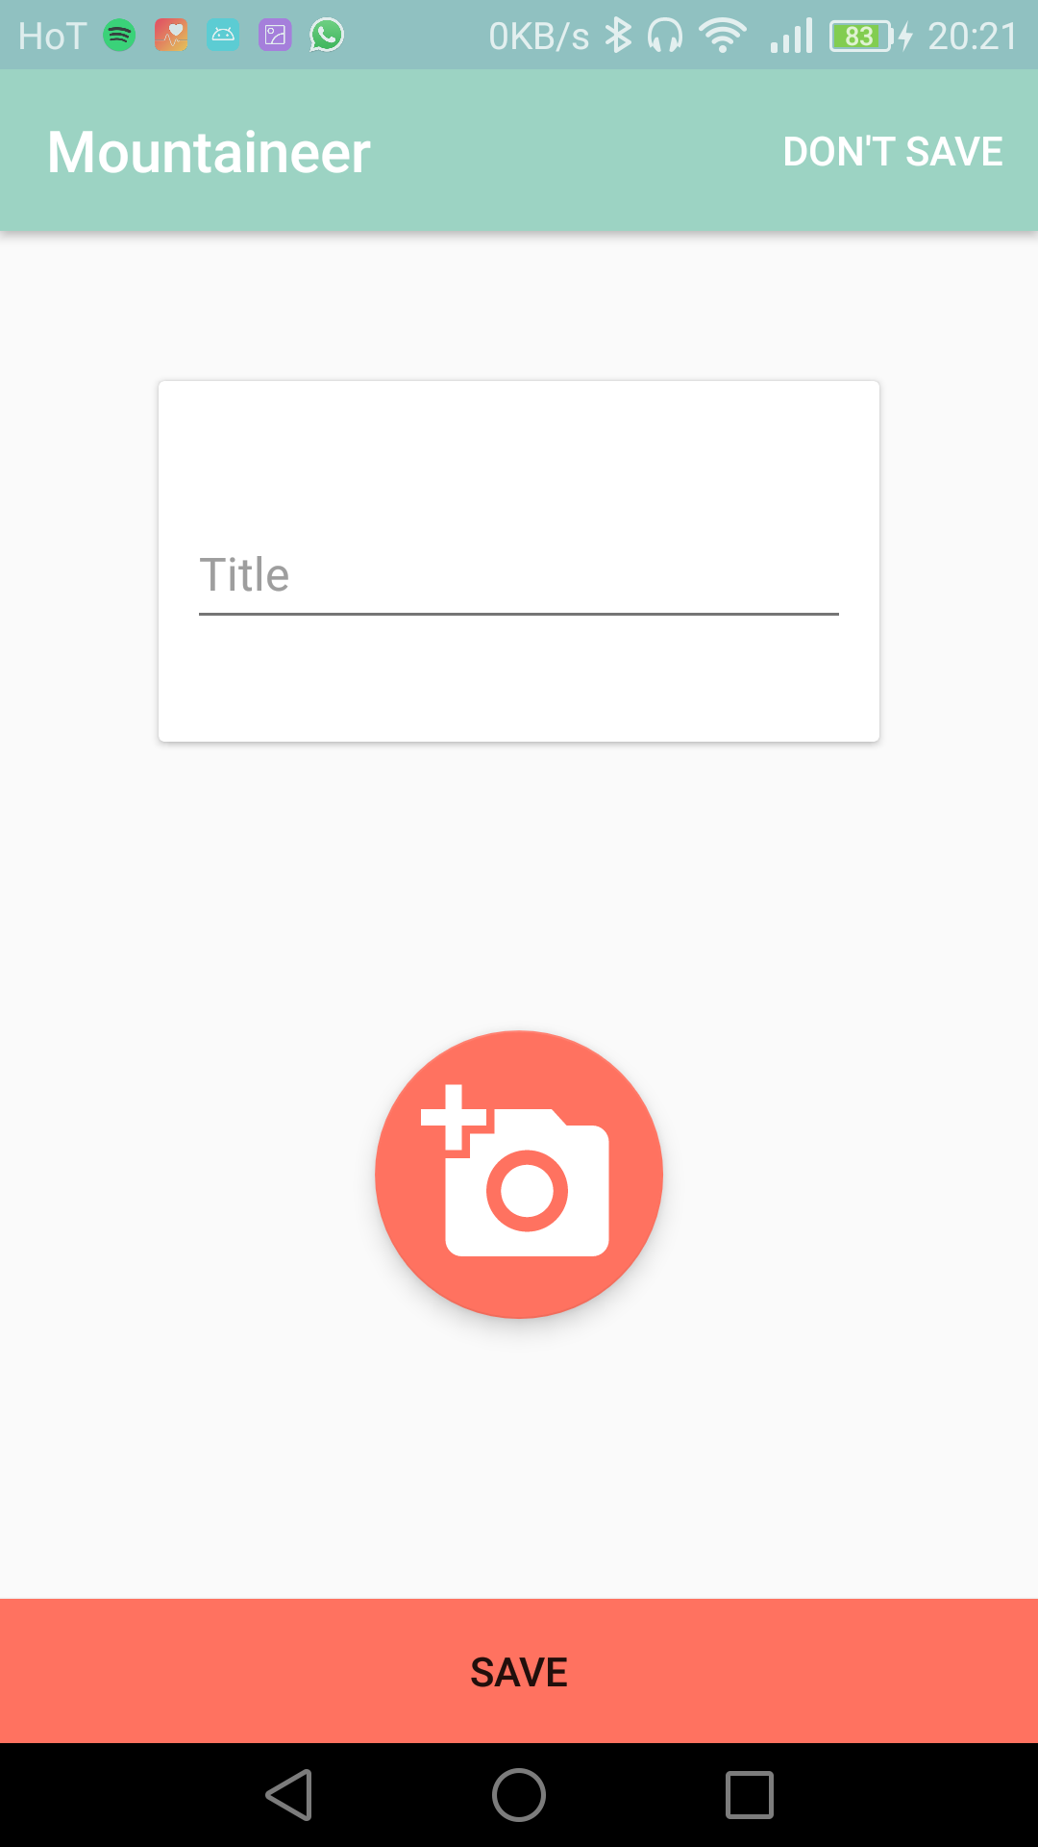
Android App #5

Slide 23
Website #1

Slide 24
Website #2

Slide 25
Website #3

Slide 26
Database Update

Slide 27
And in the code…
Basically refactored everything
Usage of Abstract Factory Pattern

